Slide 1
Natural Language Processing with Qt
Sebastiano Galazzo

Slide 2
Summary
Introduction to AI terms
What it is NLP?
Behind NLP
  Neural Networks
    QNeuralNetwork
    Demo
  Language analysys
Third party service
  Microsoft LUIS
  QLuis
  Demo

Slide 3
Introduction to AI terms
Machine Learning: As branch of Artificial Intelligence is set of algorithms based on self-improving performance, analyzing data
Artificial Intelligence: The ability of a software to perform typical human abilities and reasoning.
  Mix of machine learning algorithms
  debated among philosophers and scientists (not obvious)
Cognitive Computing: Tech platform based on AI and DSP including
  Machine Learning
  NLP
  Vision

Slide 4
What’s NLP?
Is a field of Artificial Intelligence as a mix of ML algorithms
Involved in natural language understanding
Enable computers to derive meaning from natural language input

Slide 5
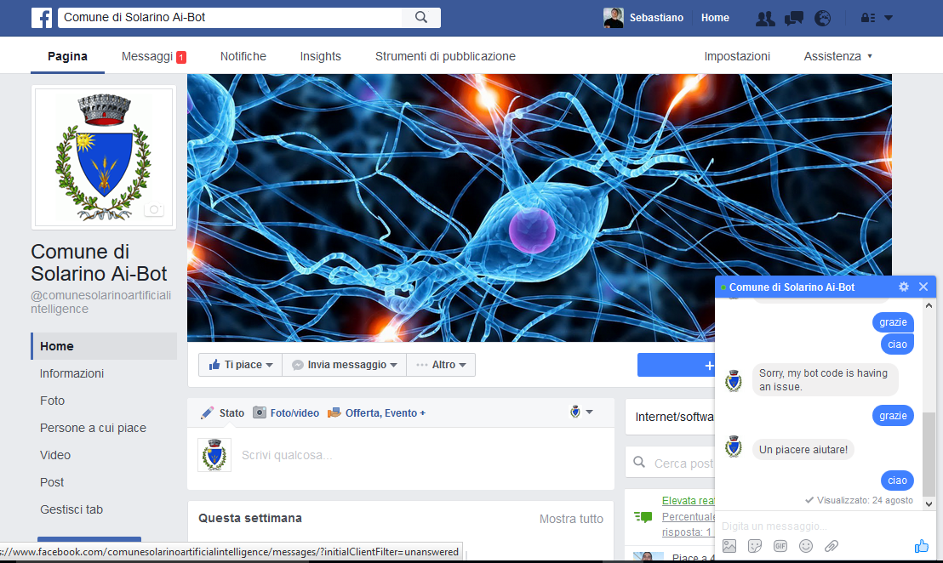
What it is NLP?
The best way to describe, is a demo
Comune di Solarino AI Bot

Slide 6
Supervised learning algorithm
The goal of any supervised learning algorithm
  To find a function that best maps a set of inputs to its correct output
An example would be a classification task
  Text analysis (Sentiment)
  Image classification

Slide 7
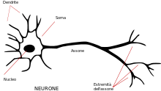
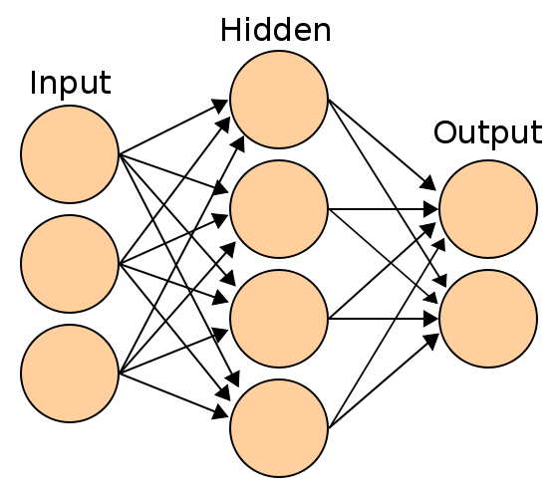
Neural Networks
Neural Networks are Mathematical models inspired to biological brain neural connections.
Multi-Layers Neural Networks solve linearly separable problems.

Slide 8
Neural Networks
  Akinator

Slide 9
Neural Networks - Backpropagation
BP is a supervised learning algorithm
Based on two phases
  Propagation
  Weight update

Slide 10
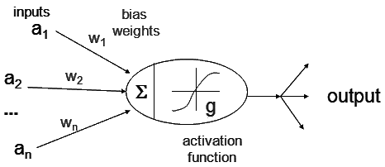
Neural Networks - Backpropagation
Propagation involves the following steps:
  Step 1: Forward propagation of a training pattern's input through the neural network in order to generate the propagation's output activations.

Slide 11
Neural Networks - Backpropagation
Step 2: Backward propagation of the propagation's output activations through the neural network using the training pattern target in order to generate the deltas (the difference between the targeted and actual output values) of all output and hidden neurons

Slide 12
Neural Networks - Backpropagation
Phase 2: Weight update, for each weight-synapse follow the following steps:
  Multiply its output delta and input activation to get the gradient of the weight.
  Subtract a ratio (percentage) from the gradient of the weight.

Slide 13
Neural Networks in Qt
Trainer
Reader

Slide 14
Syntagmas
In linguistics, a syntagma is an elementary constituent segment within a text.
Such a segment can be a phoneme, a word, a grammatical phrase, a sentence
Syntagmatic structure in a language is the combination of words according to the rules of syntax for that language

Slide 15
Syntagmas
English uses determiner + adjective + noun
  the big house
Another language might use determiner + noun + adjective (Italian, Spanish)
  la casa grande

Slide 16
Syntagmizer
Tokenize the sentence
Tag tokens based on language syntax rules Sentence::tag() and verbs to infinite form
Assembles syntagmas based on step 2

Slide 17
Syntagmizer
Has several rules to apply (sentence.cpp)
  I has been happy last night
    Happy should be labeled as adjective (A) but the label before is a verb, then is joined with previous
    Has been happy -> to be happy
Syntagmizer in Qt

Slide 18
Microsoft LUIS
luis.ai

Slide 19
QLuis
QLuis
Demo
GitHub

Slide 20

Thank you!
Sebastiano Galazzo
@galazzoseba
sebastiano.galazzo@gmail.com

